Slide 1
Spectral Clustering
Thành viên trong nhóm
Group 7
Instructors
PhD. Lương Ngọc Hoàng

Slide 2
Members of group
Trần Hoàng Bảo Ly
Đoàn Nguyễn Trần Hoàn
21521109
21520239
Lê Thanh Minh
Nguyễn Quốc Trường
21520063
21521604

Slide 3
Table of content
01
02
03
Thành viên trong nhóm
Abstract
Theoretical basis
Implementation

Slide 4
01
Abstract
Lý do chọn đề tài

Slide 5
1.1
Reason for writing
Machine Learning

Slide 6
Unsupervised learning
Machine Learning
Supervised learning
Reinforcement Learning

Slide 7
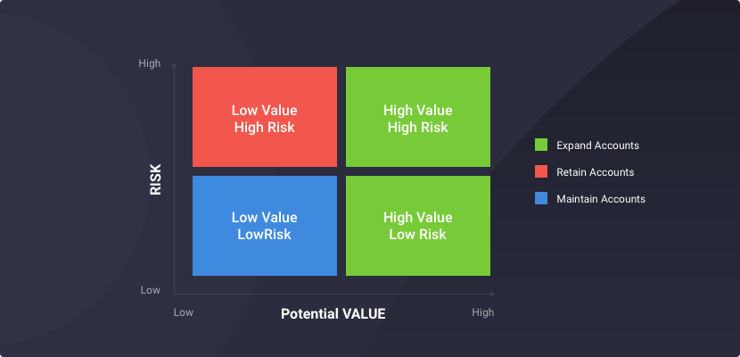
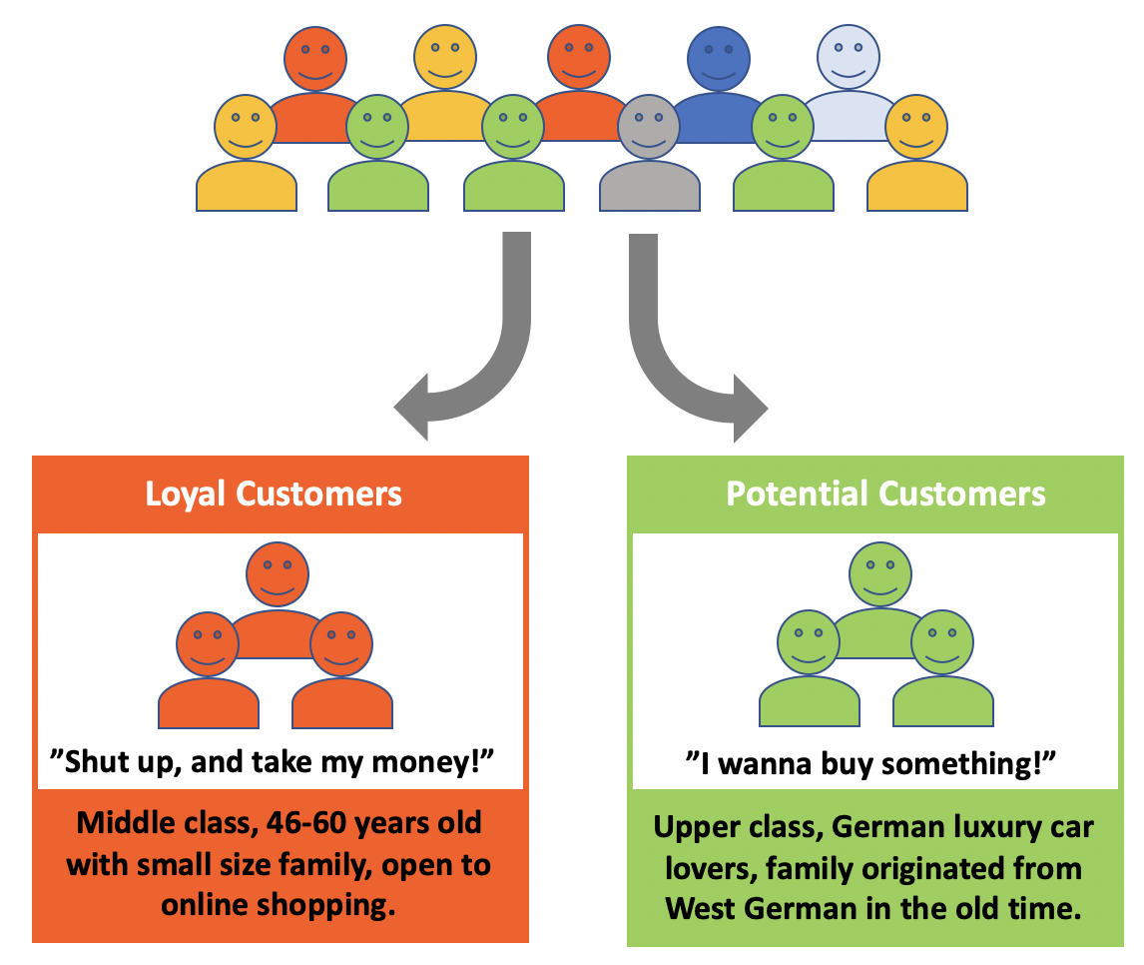

Ứng dụng của Clustering
Clustering
Unsupervised learning
Association
Anomaly detection

Slide 8
Application of Clustering
Introduction

Slide 9
1.2
Introduction
what is clustering problem

Slide 10
What is clustering problem
Ví dụ
Clustering is a type of unsupervised learning method.
It’s related to graph theory and graph clusterting.
Clustering is the task dividing datapoint into different groups, such that data points inner same group similar each other and different with data points outer that group. Based on a certain criterion.

Slide 11
What make a good cluster
Example

Slide 12
What make a good cluster
We have: a undirected graph G(V,E):
Task: Divide G into two clusters A, B. Such that A = V/B and B = V/A
Example
1
1
1
1
1
1
A
B
1
1
1
1
1
1

Slide 13
Desire
Maximize the number of edges within cluster.
Minimize the number of edges between two clusters.
1
1
1
1
1
1

Slide 14
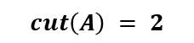

Approach 1:
Suppose that quality of the cluster A is evaluated by function cut(A) of the “edge cut” of the cluster.
“Edge cut” is a set of edges that has only one node in the cluster.
$$cut\left(A\right)=\sum_{i∈A,j∉A}{W_{ij}}$$
A
1
1
1
$$cut\left(A\right) = 2$$
1
1
1

Slide 15
So: The quality of the cluster is total sum of weight of edge with one node outside of the cluster
Degenerate case:
1
1
1
1
1
1
1
1
Problem: Cut() function just consider edges that connect two clusters and doesn’t consider edges that connect node within cluster.

Slide 16
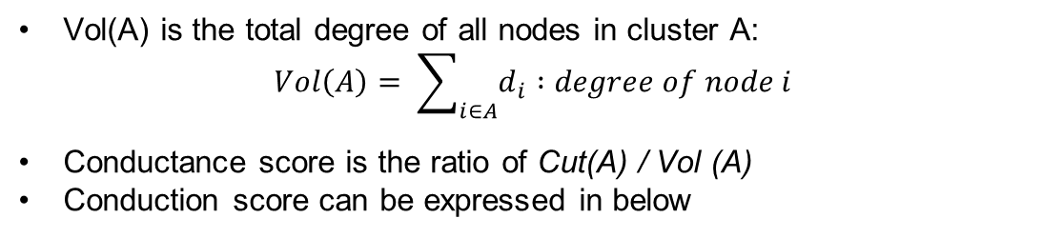
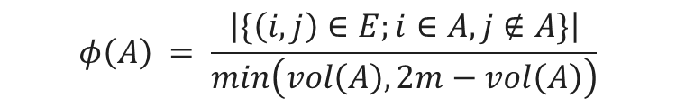
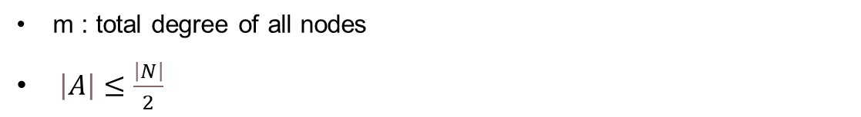
Second approach :
Conductance
Vol(A) is the total degree of all nodes in cluster A: $Vol\left(A\right)= \sum_{i∈A}{ⅆ_{i}} :degree of node i$
Conductance score is the ratio of Cut(A) / Vol (A)
Conduction score can be expressed in below
$$φ\left(A\right) = \frac{\left|\{\left(i,j\right)∈E;i∈A, j∉A\}\right|}{min\left(vol\left(A\right),2m−vol\left(A\right)\right)}$$
m : total degree of all nodes
$\left|A\right|≤\frac{\left|N\right|}{2}$
$⇒$Conductance score : the less the better

Slide 17
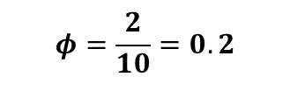
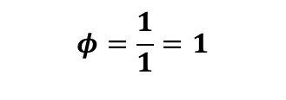
Có bao nhiêu thuật toán phân cụm?
Example
$$φ=\frac{2}{10}=0.2$$
1
1
1
1
1
$$φ=\frac{1}{1}=1$$
1
1
1

Slide 18
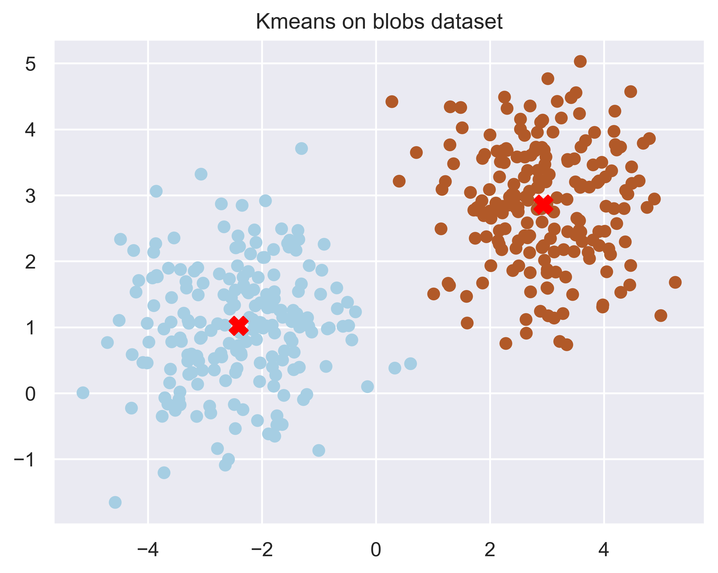
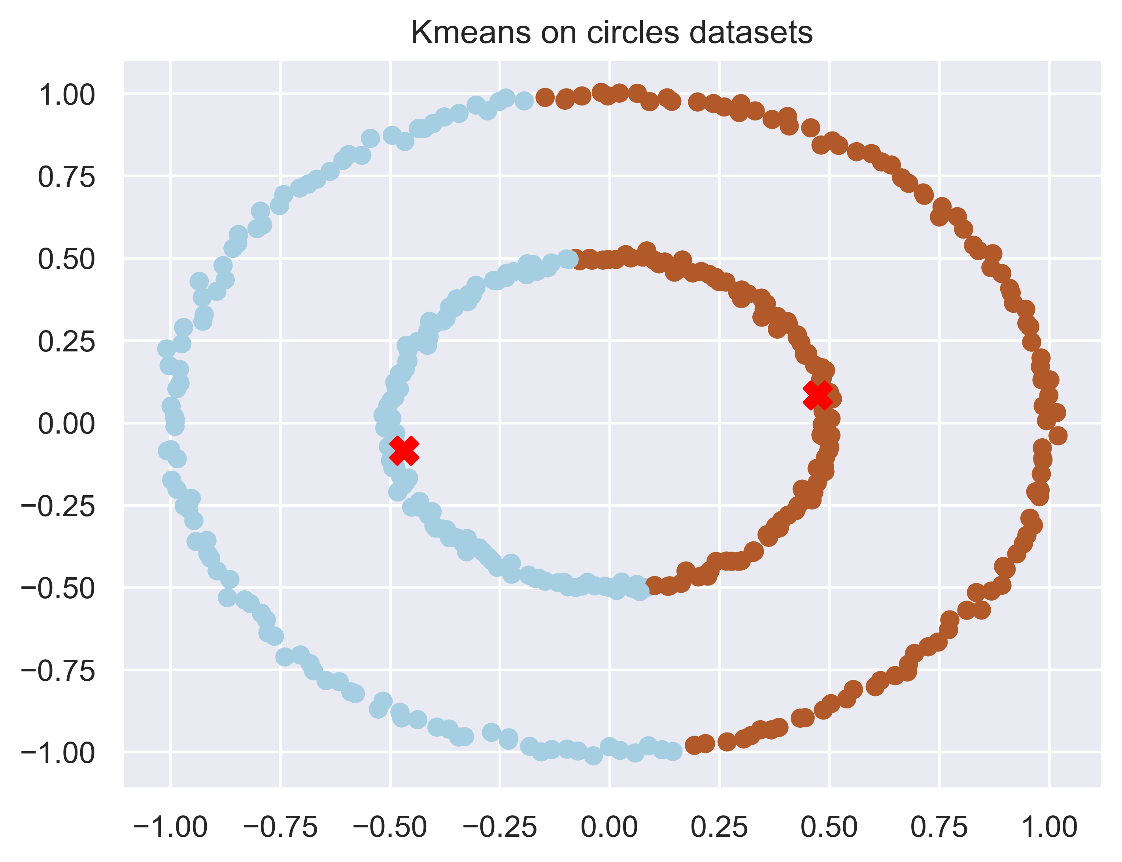
How many clustering algorithm ?
Kmeans algorithm

Slide 19
Need another clustering algorithm to solve problem ?
Spectral Clustering

Slide 20
02
Theoretical basis

Slide 21
2.1
Similarity graphs

Slide 22
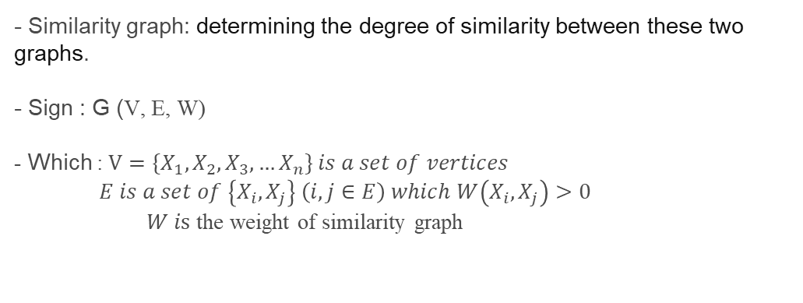
Similarity graphs
- Similarity graph: determining the degree of similarity between these two graphs.
- Sign : G (V, E, W)
- Which : $V={\{X}_{1},X_{2},X_{3},…X_{n}\} is a set of vertices$
$E is a set of \left\{X_{i},X_{j}\right\} \left(i,j∈E\right) which W\left(X_{i},X_{j}\right)>0$
$W is$ the weight of similarity graph

Slide 23
Create similarity graph
- A first step in Spectral Clustering
- We can use this graph to create similarity graph:
1
2
3
Epsilon-Neighbourhood
K-Nearest Neighbours
Fully connected graph

Slide 24

Epsilon-Neighbourhood graph
- To build the Epsilon-Neighbourhood graph, we connect all vertices which its distance less than ε (we defined ε depend on what we want ).
- Similarity weight :
$$W_{ij}=\left\{\begin{aligned}&1,\left|x_{i}−x_{j}\right| ≤ ε \\ &0, otherwise \end{aligned}\right.$$

Slide 25
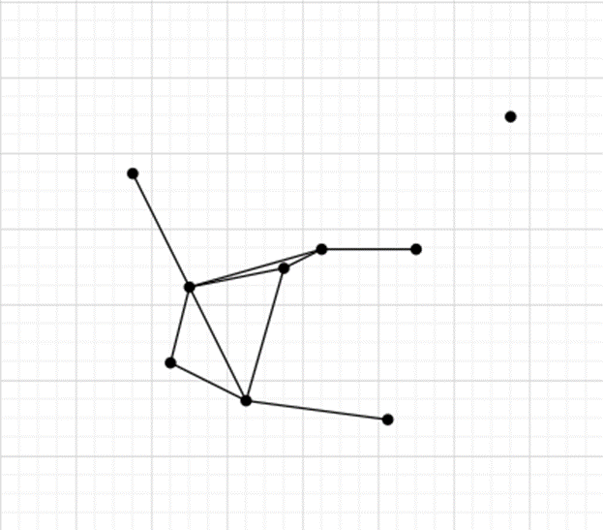
Epsilon-Neighbourhood graph
Example of Epsilon-neighbourhood graph
With ε = 2 :

Slide 26
Epsilon-Neighbourhood graph
- This is an undirectional graph
- When the distance between adjacent vertices is approximately the same level (maximum ε), weighting the edges cannot incorporate more information from the data into the graph. -> Graphs are generally considered to be unweighted graphs
- It really hard to choose a suitable ε in Epsilon-neighbourhood graph.
- Epsilon-neighbourhood graph cannot connect data points from different data levels

Slide 27
K-Nearest Neighbours Graph
- Aim : connect vertex x_{i} with vertex x_{j} if x_{j} in k-Nearest neighbour of x_{i}.
- However, this will make a graph become a directional graph (may be x_{j} in k-nearest neighbour of x_{i} but x_{i} not in k-nearest neighbour of x_{j}.
- There is 2 method to make this graph become undirectional graph again

Slide 28
K-Nearest Neighbours Graph
- Method 1: Ignore the direction of edge. We connect x_{i} and x_{j} by undirectional edge if x_{i} in k-nearest neighbour of x_{j} or vice versa
- Method 2: We connect x_{i} and x_{j} only if both of them in k-nearest neighbour of each other

Slide 29
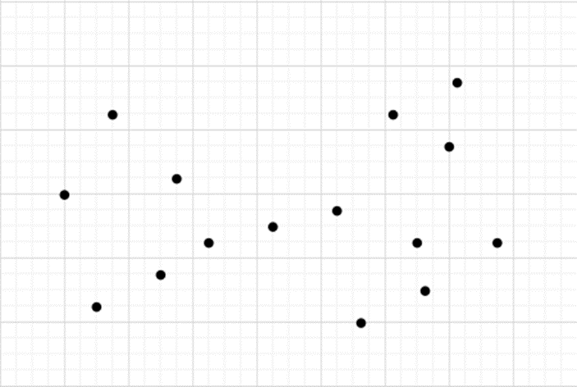
K-Nearest Neighbours Graph
Example : Given dataset

Slide 30
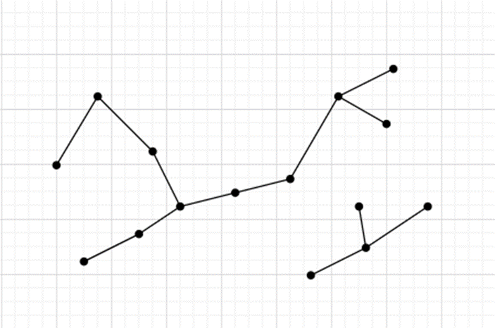
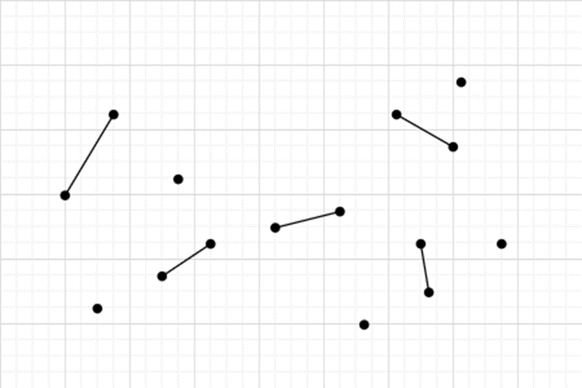
K-Nearest Neighbours Graph
kNN graph was created by using method 1
kNN graph was created by using method 2

Slide 31
K-Nearest Neighbours Graph
- The kNN graph obtained in first method can connect data points on different data levels.​
​
- The kNN graph obtained in second method tends to join data points in regions of the same density, but not in regions of different density.​
​
Therefore, it can be considered as a kind of graph between epsilon-neighbourhood graph and kNN graph.​

Slide 32

Fully connected graph
- To create this graph, every node in graph will be connected with another unidirectional edge having weight
- The relativity of 2 node X_{i}, X_{j} can be evaluated based on Gauss’s distribution:
- σ : standard deviation.
- Wij use to adjust the size of cluster. The higher the value Wij is, the more the connectivity of Xi and Xj .
$$W_{ij}=e^{\frac{{\left|x_{i}−x_{j}\right|}^{2}}{2σ^{2}}}$$

Slide 33
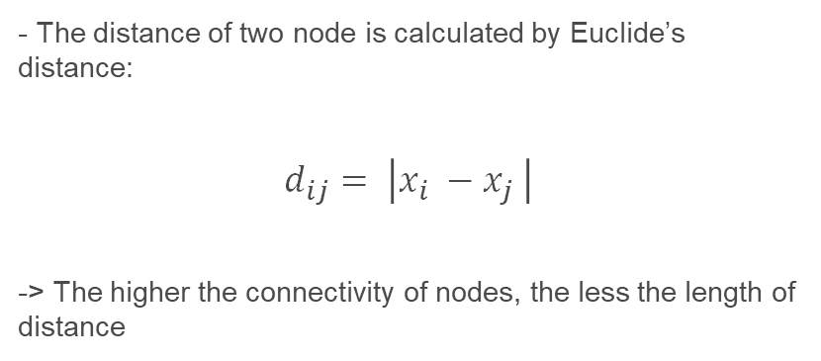
Fully connected graph
- The distance of two node is calculated by Euclide’s distance:
$$d_{ij}= \left|x_{i} −x_{j} \right|$$
-> The higher the connectivity of nodes, the less the length of distance

Slide 34
2.2
Projecting the data onto a lower Dimensional Space

Slide 35
Our Solutions
Adjacency Matrix
Degree Matrix
01
02
From graph, create adjacency matrix (A)
From adjacency matrix, create degree matrix (D)
Laplacian Matrix
Eigenvector and Eigenvalue
03
04
L = D-A
Calculate eigenvectors and eigenvalue of Laplacian Matrix

Slide 36
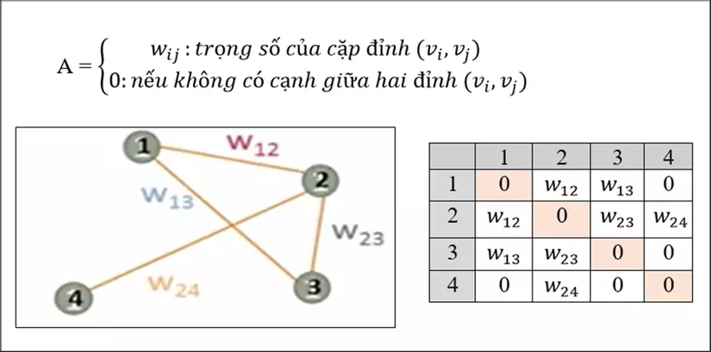
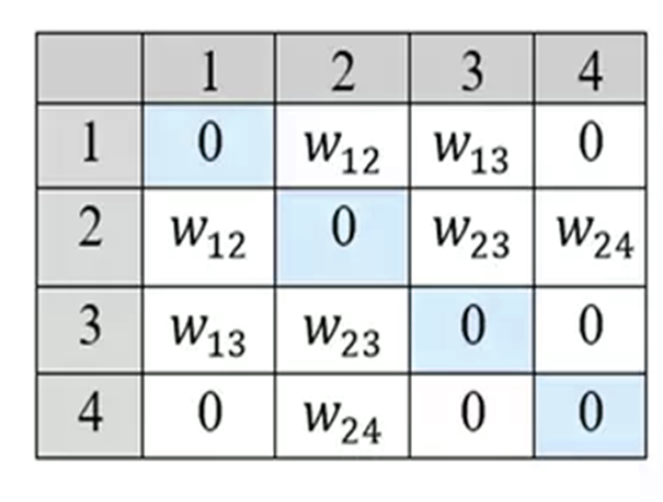
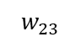
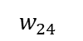
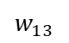
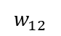
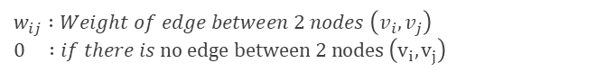
Adjacency matrix
$$w_{ij} :Weight of edge between 2 nodes \left(v_{i}, v_{j}\right) \\ 0 :if there is no edge between 2 nodes \left(v_{i},v_{j}\right)$$
$$w_{12}$$
1
2
$$w_{13}$$
$$w_{24}$$
$$w_{23}$$
4
3
Important properties :
- Is a symmetric matrix - Has n eigenvector (n: size of matrix)
- Orthogonal eigenvectors

Slide 37
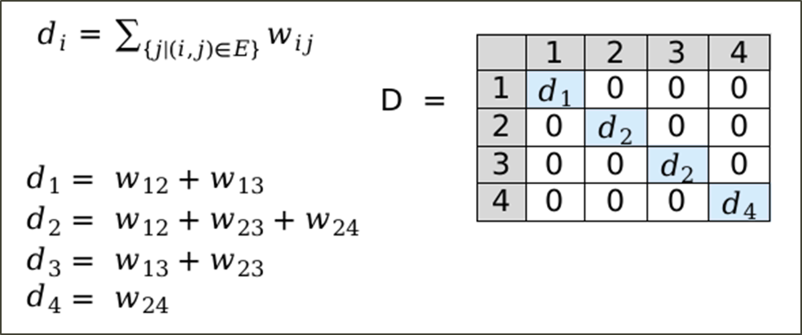
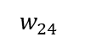
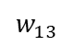
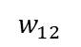
Degree Matrix
$$w_{12}$$
1
2
$${Which is, d}_{i} is an degree of node i$$
$$w_{13}$$
$$w_{24}$$
$$w_{23}$$
4
3

Slide 38
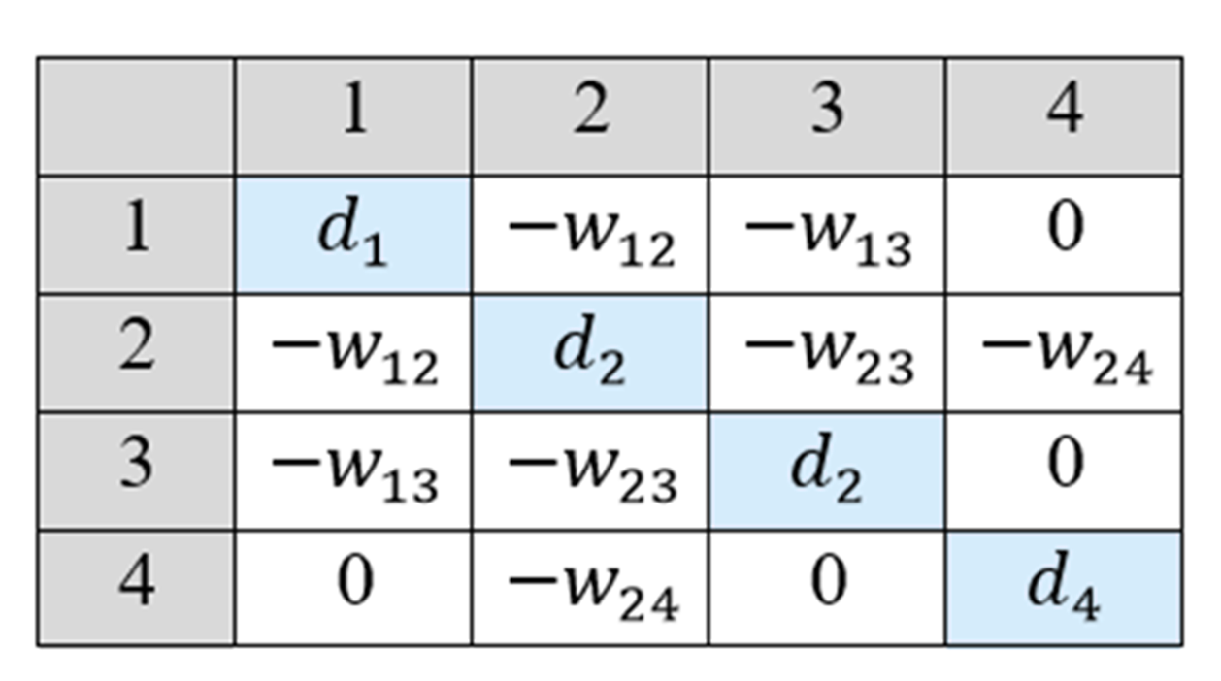
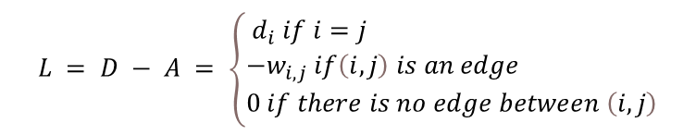
Laplacian Matrix
$$L = D − A = \left\{\begin{aligned}&{ d}_{i} if i=j \\ &−w_{i,j} if\left(i,j\right) is an edge \\ &0 if there is no edge between \left(i,j\right)\end{aligned}\right.$$
Properties:
- Always have the eigenvector (1,1,…,1) with eigenvalue 0
- The number of eigenvalue equals to 0 is the number of connected components of the graph(Kirchhoff theory )
Laplacian matrix

Slide 39
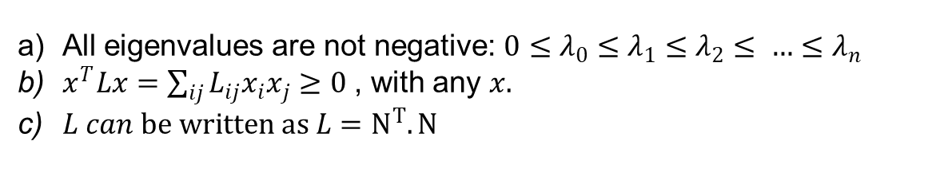
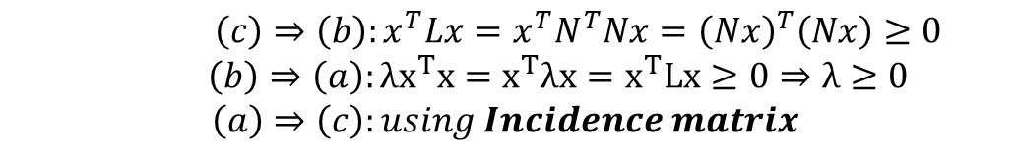
Property
All eigenvalues are not negative: $0≤λ_{0}≤λ_{1}≤λ_{2}≤ …≤λ_{n}$
$x^{T}Lx=\sum_{ij}{L_{ij}x_{i}x_{j}≥0}$ , with any $x.$
$L can be written as L=N^{T}.N$
Proof:
$\left(c\right)⇒\left(b\right):x^{T}Lx=x^{T}N^{T}Nx={\left(Nx\right)}^{T}\left(Nx\right)≥0$
$$\left(b\right)⇒\left(a\right):λx^{T}x=x^{T}λx=x^{T}Lx≥0⇒λ≥0$$
$$\left(a\right)⇒\left(c\right):using Incidence matrix$$

Slide 40
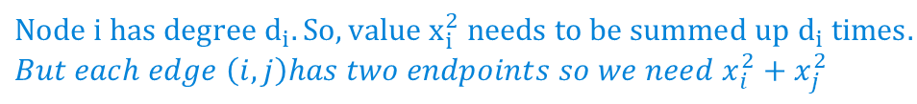
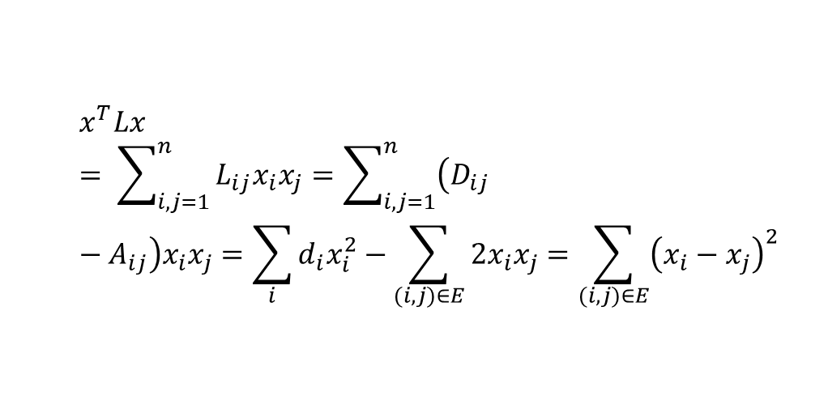
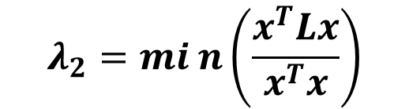
Optimize problem
$$λ_{2}=min\left(\frac{x^{T}Lx}{x^{T}x}\right)$$
Which is:
$$x^{T}Lx= \sum_{i,j=1}^{n}{L_{ij}x_{i}x_{j}=\sum_{i,j=1}^{n}{\left(D_{ij}−A_{ij}\right)x_{i}x_{j}=\sum_{i}{d_{i}x_{i}^{2}−\sum_{(i,j)∈E}{2x_{i}x_{j}=\sum_{(i,j)∈E}{{\left(x_{i}−x_{j}\right)}^{2}}}}}}$$
$$Node i has degree d_{i}. So, value x_{i}^{2} needs to be summed up d_{i} times. \\ But each edge \left(i,j\right)has two endpoints so we need x_{i}^{2}+x_{j}^{2}$$

Slide 41
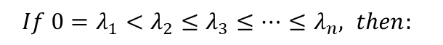
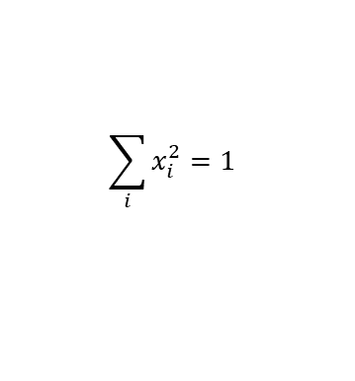
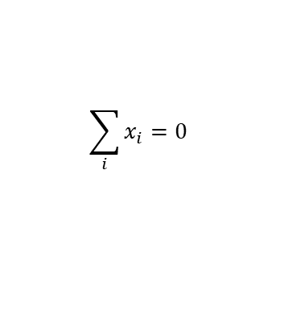
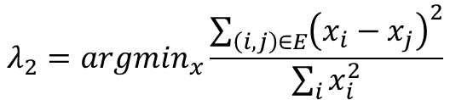
Optimize problem
Beside :
- x is a unit vector:
- x orthogonal with first eigenvector (1,1,…,1) :
$$\sum_{i}{x_{i}^{2}=1}$$
$$\sum_{i}{x_{i}=0}$$
$If 0=λ_{1}<λ_{2}≤λ_{3}≤…≤λ_{n}, then:$
$$λ_{2}=argmin_{x}\frac{{\sum_{\left(i,j\right)∈E}{\left(x_{i}−x_{j}\right)}}^{2}}{\sum_{i}{x_{i}^{2}}}$$

Slide 42
2.3
Clustering data

Slide 43
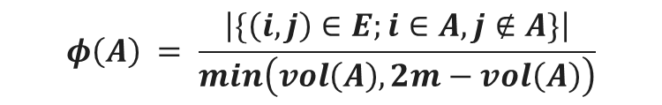
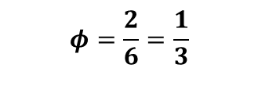
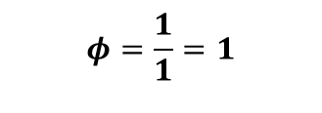
Summarize
$$φ\left(A\right) = \frac{\left|\{\left(i,j\right)∈E;i∈A, j∉A\}\right|}{min\left(vol\left(A\right),2m−vol\left(A\right)\right)}$$
Criterion
$$φ=\frac{2}{6}=\frac{1}{3}$$
How to find optimal cut ? : NP hard
1
1
1
1
1
$$φ=\frac{1}{1}=1$$
1
1
1

Slide 44
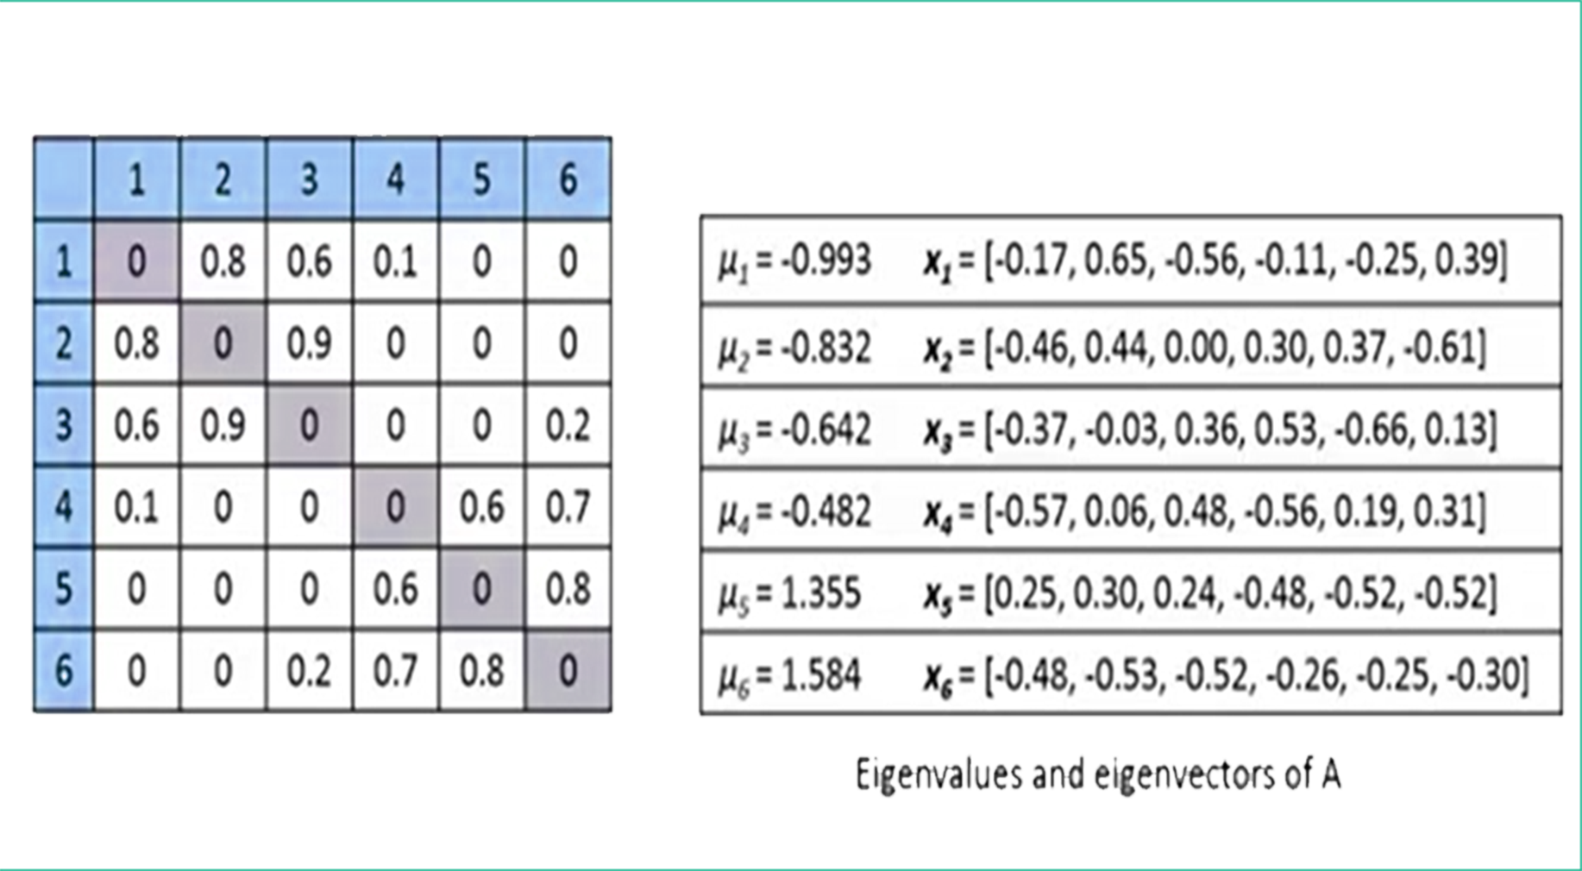
Summarize
- Transform graph (with weight) into Laplace matrix
- Compute Eigenvalues and eigenvector of Laplace matrix
0.8
1
2
0.1
0.6
0.9
4
3
0.6
0.7
0.2
5
6
0.8
Graph A
adjacency matrix of A
Eigenvalues and eigenvectors of A

Slide 45
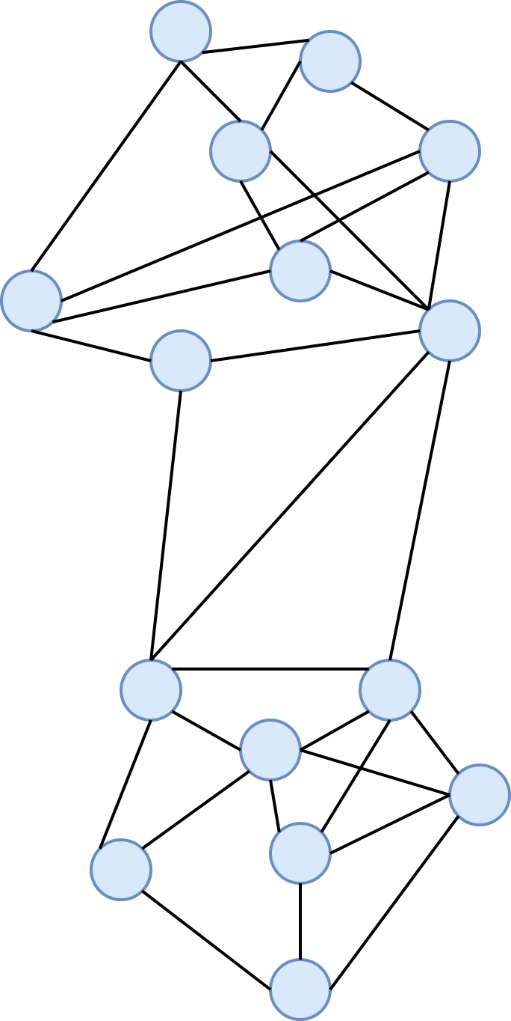
Summarize
X₂ value

Slide 46
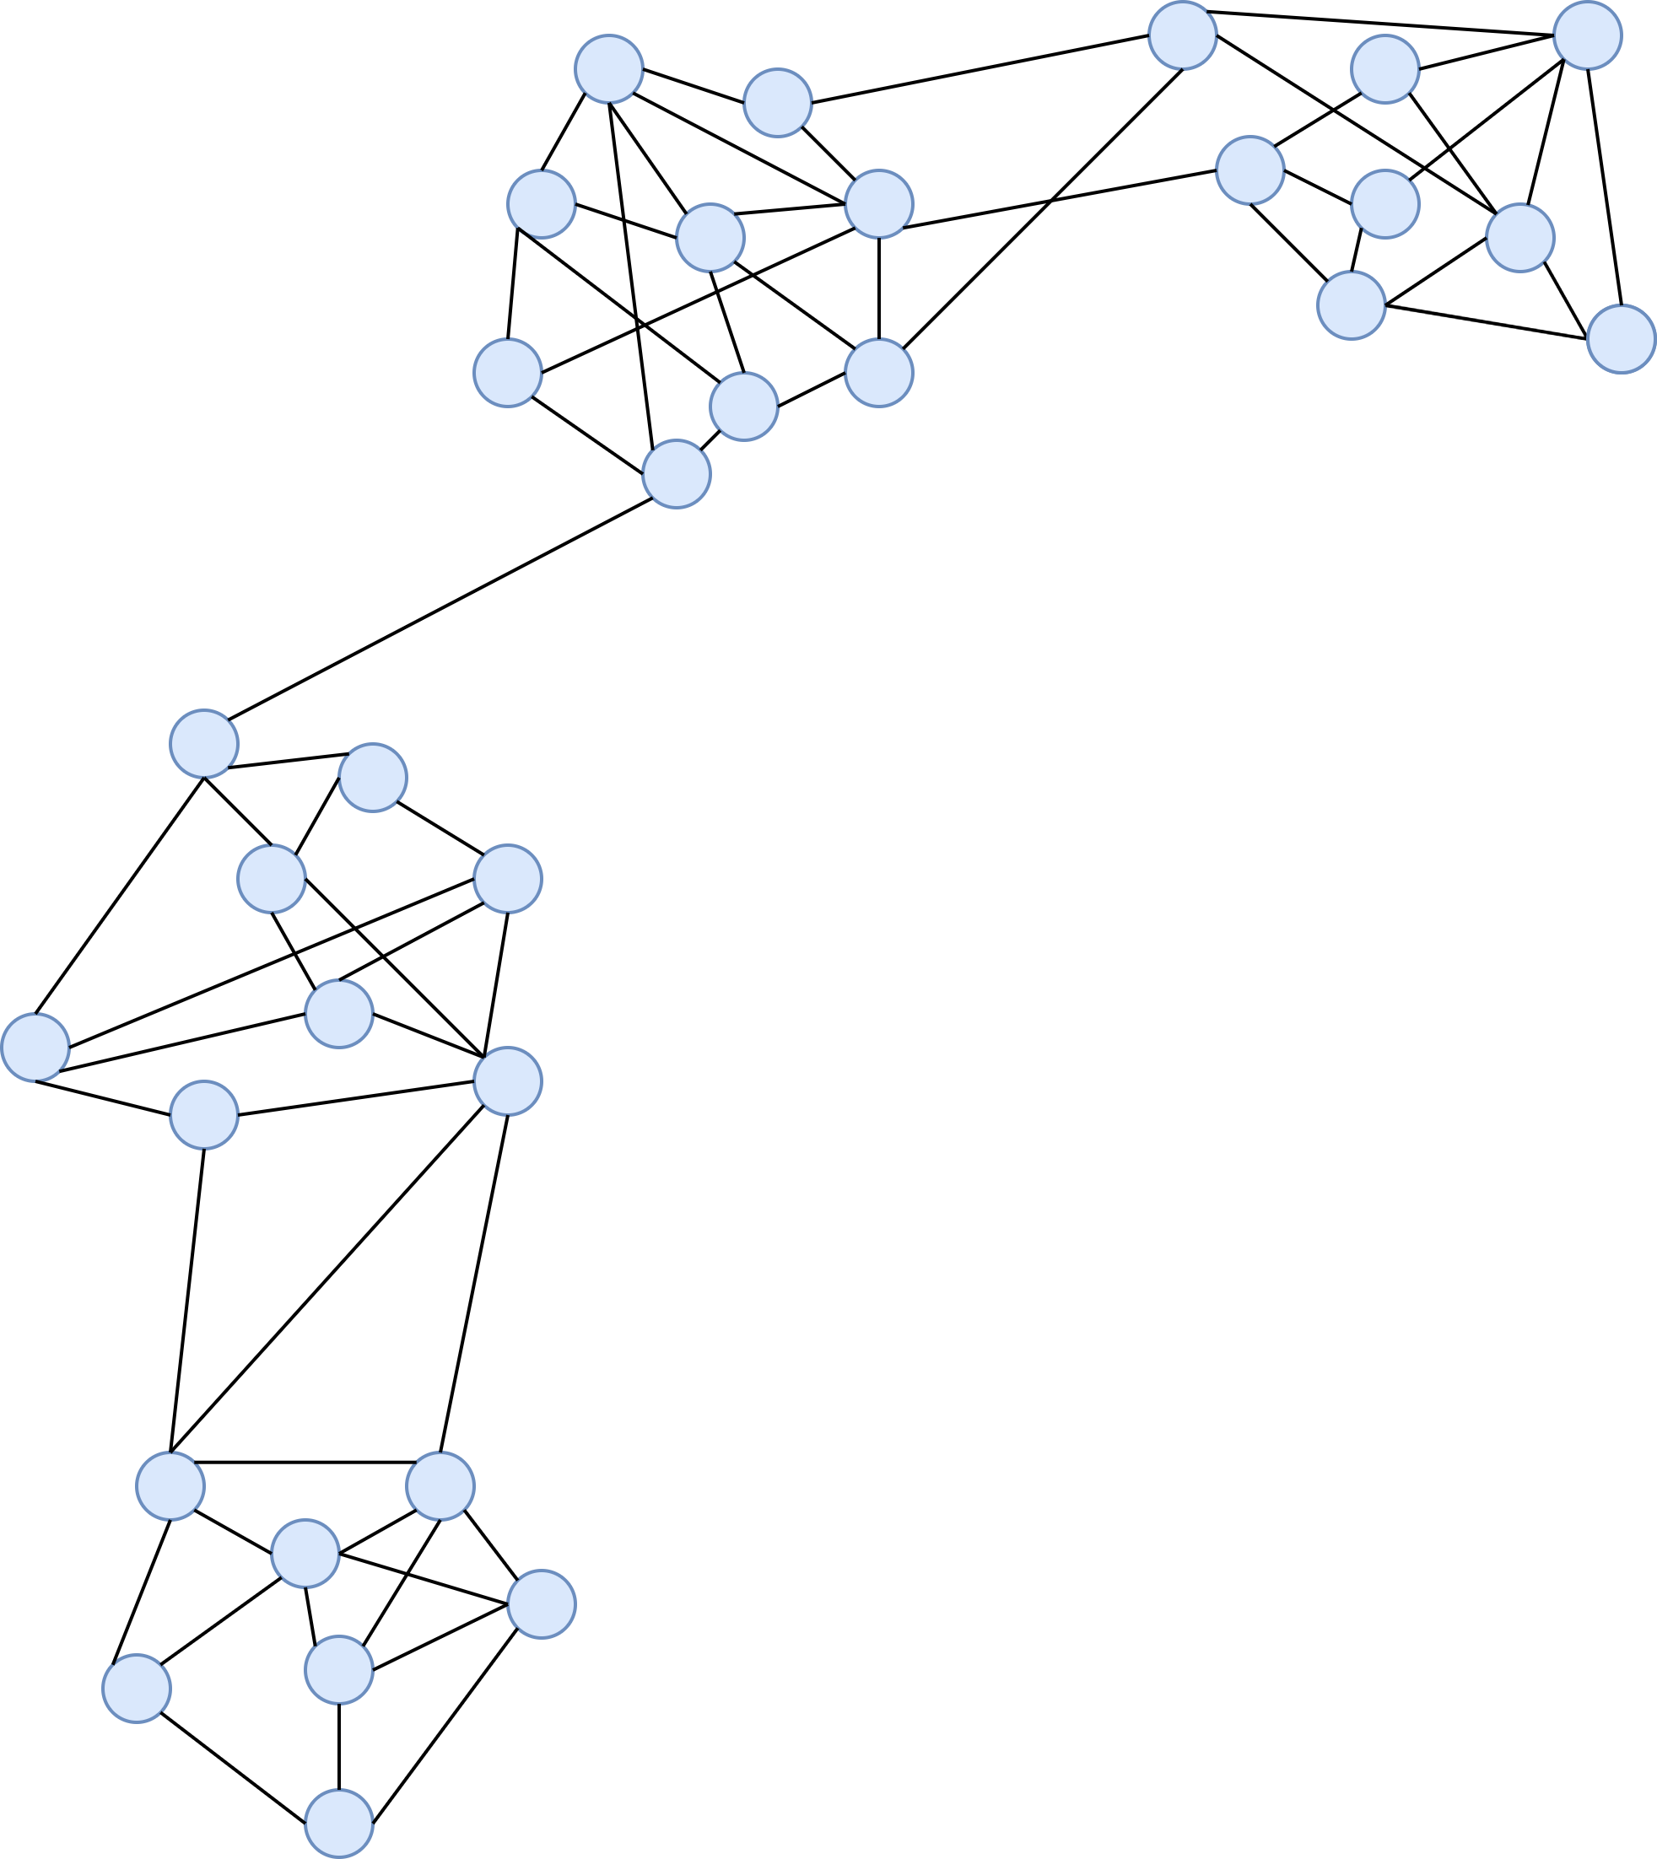
Summarize
X₂ value

Slide 47
Summarize
X₁ value
X₃ value

Slide 48
Summarize
How do we partition a graph into k clusters ?
There are 2 basic approaches :
Recursive bi-partioning : Inefficient and unstable
Cluster multiple eigenvectors :
+ Build a reduced dimension-space from multiple eigenvectors
+ Commonly used in recent papers
+ A preferable approach...
X₁ value
X₃ value

Slide 49
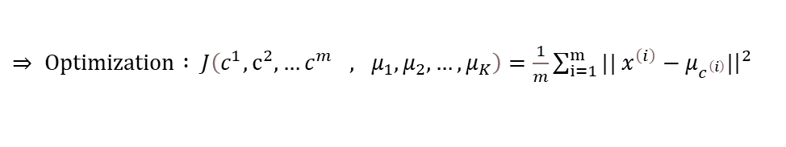
Optimization
$c^{\left(i\right)}$: index of cluster (1,2,... K) which points $x^{\left(i\right)} currently$ assigned
$μ_{K}$: cluster centroid k (${μ_{K}∈R}^{n})$
$μ_{c^{\left(i\right)}}$: cluster centroid of cluster to which example $x^{\left(i\right)}$ has been assigned
$⇒ Optimization : J\left(c^{1},c^{2},…c^{m} , μ_{1},μ_{2},…,μ_{K}\right)=\frac{1}{m}\sum_{i=1}^{m}{|| x^{\left(i\right)}−μ_{c^{\left(i\right)}}|{\left.​\right|}^{2}}$

Slide 50
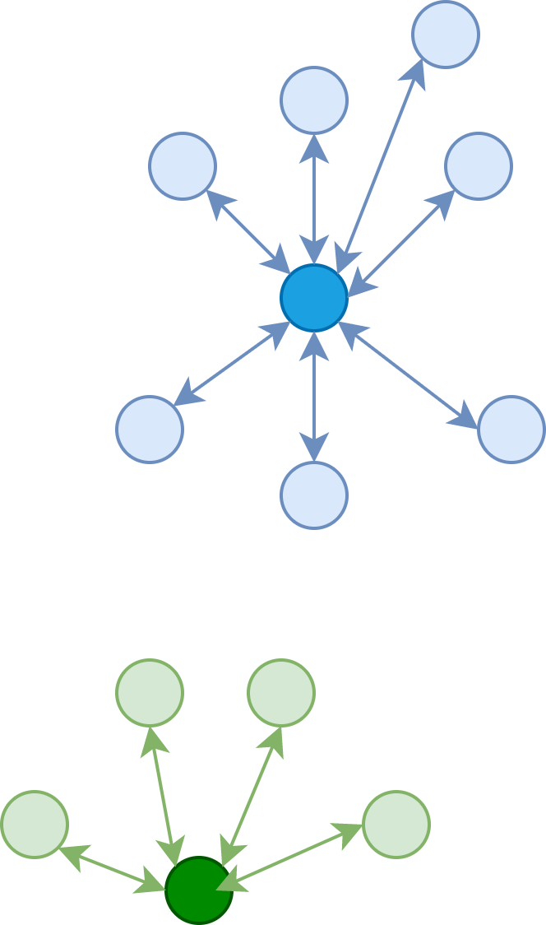
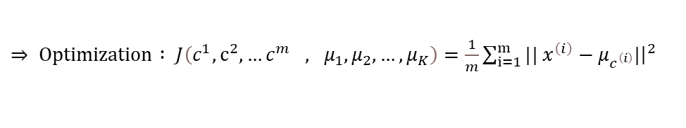
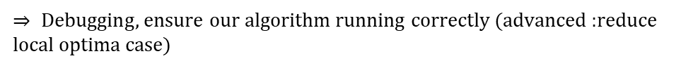
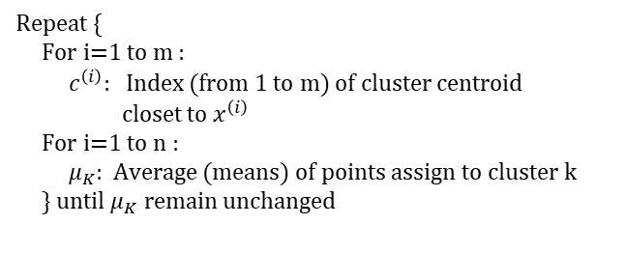
Optimization
$⇒ Optimization : J\left(c^{1},c^{2},…c^{m} , μ_{1},μ_{2},…,μ_{K}\right)=\frac{1}{m}\sum_{i=1}^{m}{|| x^{\left(i\right)}−μ_{c^{\left(i\right)}}|{\left.​\right|}^{2}}$
Repeat {
For i=1 to m :
$c^{\left(i\right)}:$ Index (from 1 to m) of cluster centroid
closet to $x^{\left(i\right)}$
For i=1 to n :
$μ_{K}$: Average (means) of points assign to cluster k
} until $μ_{K} remain$ unchanged
$⇒ Debugging$, ensure our algorithm running correctly (advanced :reduce local optima case)

Slide 51
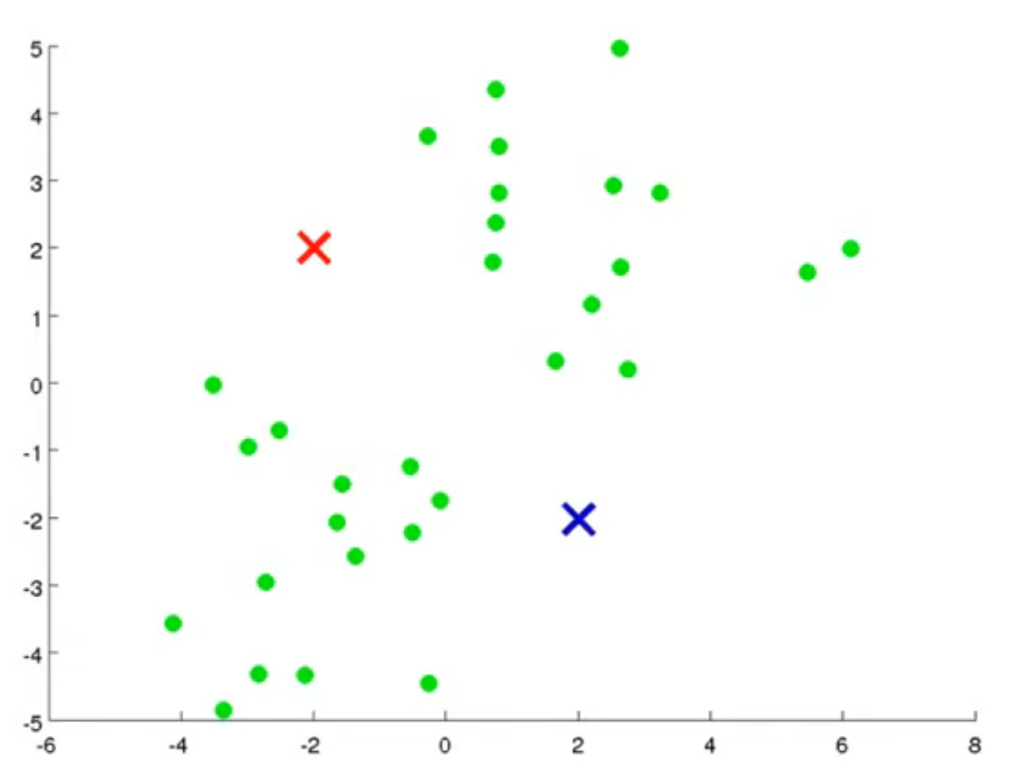






Clustering
Kmeans algorithm :
Randomly initialize K cluster centroid $μ_{1},μ_{2},μ_{3},…μ_{K}∈R$
Repeat {
For i=1 to m :
$c^{\left(i\right)}:$ Index (from 1 to m) of cluster centroid
closet to $x^{\left(i\right)}$
For i=1 to n :
$μ_{K}$: Average (means) of points assign to cluster k
} until $μ_{K} remain$ unchanged

Slide 52





Initialize cluster centroid
Local optima
$J\left(c^{1},c^{2},…c^{m} , μ_{1},μ_{2},…,μ_{K}\right)=\frac{1}{m}\sum_{i=1}^{m}{|| x^{\left(i\right)}−μ_{c^{\left(i\right)}}|{\left.​\right|}^{2}}$

Slide 53

Initialize cluster centroid
Loop 50-1000 times : Generate randomly K-means
Run K-means
Calculate cost function (distortion)
$J\left(c^{1},c^{2},…c^{m} , μ_{1},μ_{2},…,μ_{K}\right)$
Save the value : $c^{1},c^{2},…c^{m}, μ_{1},μ_{2},…,μ_{K} and$ J
=> Choose in saved data the one have smallest J value (Optimal random case)
Choosing number of clusters

Slide 54

Choosing number of clusters
This is elbow point, we chose x value at this point is number of clusters

Slide 55
Configuration
Example with k = 2 follow elbow method above
We have nearly perfect clusters

Slide 56
03
Implementation

Slide 57
Process
Step 1: Create adjacency matrix from data using K-neighbors algorithm. From that, create a Laplacian matrix.
Step 2: Calculate all eigenvalues and eigenvectors of Laplacian matrix, then sort all the eigenvalues (increasing order) to have Laplacian's eigenvalues spectrum.
Step 3: Choosing k (you can choose k) eigenvectors corresponding to first k eigenvalues in spectrum from step 2.
Step 4: Using Kmeans to cluster based on k-vector matrix in step 3. The result of Kmeans algorithm is the solution.

Slide 58
MySpectralClustering
class MySpectralClustering:
def __init__(self, n_cluster = 3, random_state = None, n_neighbor = 10):
self.k = n_cluster
self.seed = random_state
self.nneighbor = n_neighbor
super.__init__

Slide 59
MySpectralClustering
def __generateGraphLaplace(self,X):
#find connect use kneighbors algorithm
connectivity = kneighbors_graph(X = X, n_neighbors=self.nneighbor)
#build adjacenty Matrix
adjacentyMatrix = (1/2)*(connectivity+ connectivity.T)
#build laplace matrix
graphLaplaceS = sparse.csgraph.laplacian(csgraph=adjacentyMatrix, normed=False)
graphLaplace = graphLaplaceS.toarray()
self.laplaceMatrix = graphLaplace

Slide 60
MySpectralClustering
def __getEigenVectorMatrix(self):
#ucalcute eigenvalues and eigenvectors crosssponding to
eigenValues, eigenVectors = linalg.eig(self.laplaceMatrix)
eigenValues = np.real(eigenValues)
eigenVectors = np.real(eigenVectors)
#sort eigenvalues to get spectral
eigenValuesSortIndices = np.argsort(eigenValues)
# get k eigenValues first of spectral
Indices = eigenValuesSortIndices[:self.k]
return eigenVectors[:, Indices.squeeze()]

Slide 61
MySpectralClustering
def fit(self, X):
self.__generateGraphLaplace(X)
EigenVectorsMatrix = self.__getEigenVectorMatrix()
#to avoid error when data just has 1 fetures
if (self.k == 1):
EigenVectorsMatrix = EigenVectorsMatrix.reshape(1,-1)
#use kmeaans to cluster on k eigenvector first of spetral eigenvector
kMeans = KMeans(n_clusters=self.k, random_state=self.seed).fit(EigenVectorsMatrix)
self.labels_ = kMeans.labels_
self.inertia_ = kMeans.inertia_
return self

Slide 62

Development
Notes: With a symmetric matrix M we have$λ_{2} =min_{x}\frac{x^{T}Mx}{x^{T}x}$
Recall that by assumption: $x^{T}Lx=\sum_{i,j∈E}{{\left(x_{i}−x_{j}\right)}^{2}}$
Expectation: find $x$ to minimize $λ_{2}$
Theory about $x$:
$x$ is an unit vector : $\sum_{i}{x_{i}^{2}=1}$.
$x$is orthogonal to 1st eigenvector $λ_{1}$(1,1,..,1), thus$:$
$\sum_{i}{x_{i}.1=\sum_{i}{x_{i}=0}}$

Slide 63

In Laplacian Matrix. $λ_{2}$ is the second smallest eigenvalue, Or the second eigenvalue in spectral also know as Fiedler eigenvalue after Miroslav Fiedler (Czech Mathematician).
This property can describe: If this value positive, this is a connected graph. If this value equal to 0. This graph will include 2 connected graph.
Consequence: The number of eigenvalue in Laplacian Matrix equal to 0 is the number of connected graph.
In reality, It is hardly to see a fully separated graph. So we usually take eigenvalue that $≈0$.
Every Fiedler’s eigenvalue has a eigenvector called Fiedler’s eigenvector.
=> The number of Fiedler’s eigenvalues is the number of clusters (In relatively way)

Slide 64
From MySpectralClustering
class MySpectralClustering:
def __init__(self, n_cluster = 3, random_state = None, n_neighbor = 10):
self.k = n_cluster
self.seed = random_state
self.nneighbor = n_neighbor
super.__init__

Slide 65
To AutoKSpectralClustering
class AutoSpectralClustering:
def __init__(self, threshold = 1e-2, random_state = None, n_neighbor = 10):
self.seed = random_state
self.nneighbor = n_neighbor
self.threshold = threshold
super.__init__

Slide 66
From MySpectralClustering
def __getEigenVectorMatrix(self):
#ucalcute eigenvalues and eigenvectors crosssponding to
eigenValues, eigenVectors = linalg.eig(self.laplaceMatrix)
eigenValues = np.real(eigenValues)
eigenVectors = np.real(eigenVectors)
#sort eigenvalues to get spectral
eigenValuesSortIndices = np.argsort(eigenValues)
# get k eigenValues first of spectral
Indices = eigenValuesSortIndices[:self.k]
return eigenVectors[:, Indices.squeeze()]

Slide 67

To AutoKSpectralClustering
So sánh thời gian và kết quả các thuật toán
def __getEigenVectorMatrix(self):
#ucalcute eigenvalues and eigenvectors crosssponding to
eigenValues, eigenVectors = linalg.eig(self.laplaceMatrix)
eigenValues = np.real(eigenValues)
eigenVectors = np.real(eigenVectors)
#get eigenvalue Fiedler
zeroEigenValueIndex = np.argwhere(abs(eigenValues) < self.threshold)
self.k, _ = zeroEigenValueIndex.shape
#get eigenvector Fiedler crossponding to eigenvalue Fiedler
return eigenVectors[:, zeroEigenValueIndex.squeeze()]

Slide 68

Time and algorithm comparasion
Note : Kmeans and Spectral from scikit-learn library, MySpectral and AutoKSpectral was implemented in demo code.

Slide 69

Evaluation

Slide 70
Solution
Using mini batch.
K-loop.
Choosing n (A small part of data point) to divide cluster.

Slide 71

Solution
Optimize algorithm:
The complexity of algorithm (big-O notation) spectral clustering come from the calculation of eigenvalues and eigenvectors $(O\left(n^{3}\right))$.
To reduce the complexity of this algorithm, we need to reduce the calculation process of finding eigenvalues and eigenvectors by rounding value$.^{(5)}$

Slide 72
Related link:
All the demonstrate code and fig was generated by code are saved on Github: Click here
‌
‌

Slide 73
References
Leskovec, J. (n.d.). CS224W: Machine Learning with Graphs. Retrieved December 27, 2022.
sklearn.cluster.SpectralClustering. (2019). Scikit-Learn. https://scikit-learn.org/stable/modules/generated/sklearn.cluster.SpectralClustering.html
Fleshman, W. (2019, February 21). Spectral Clustering - Towards Data Science. Medium; Towards Data Science. https://towardsdatascience.com/spectral-clustering-aba2640c0d5b
Langone, R., & Suykens, J. A. K. (2017). Fast kernel spectral clustering. Neurocomputing, 268, 27–33. https://doi.org/10.1016/j.neucom.2016.12.085
The Nyström Method for Finding Eigenpairs of a Kernel Function - Boostedml. (2020, August 29). Boostedml. https://boostedml.com/2020/08/the-nystrom-method-for-finding-eigenpairs-of-a-kernel-function.html
‌
‌

Slide 74
Thanks for listening our presentation!!

Slide 75


